Slide 1
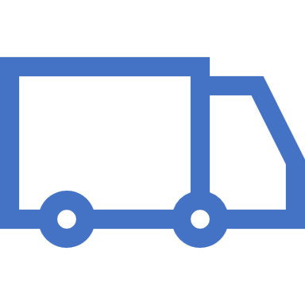
Continuous Delivery

Slide 2
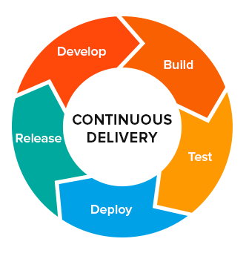
Will Be A Nightmare With Downtime

Slide 3
Routes
The Cloud Foundry Gorouter routes requests to apps by associating an app with an address, known as a route.
We call this association a mapping.
The routing tier compares each request with a list of all the routes mapped to apps and attempts to find the best match.
Routes have independent lifecycle , they doesn’t depends on apps.
Apps and Routes can have many to many relationship.
It means one app can have multiple routes, and one route can have multiple apps bound to it.

Slide 4

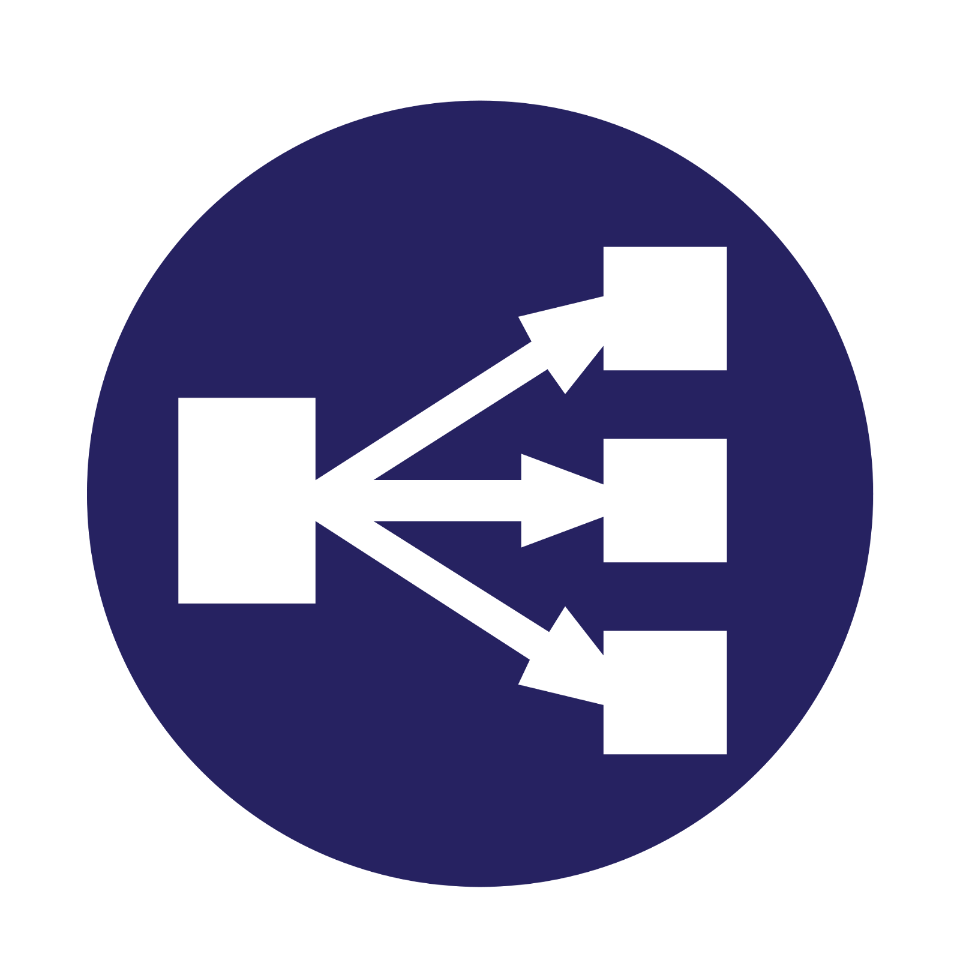

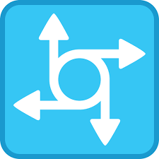

Route Service Request Flow
Client
Load Balancer
Router
App
Route Services

Slide 5

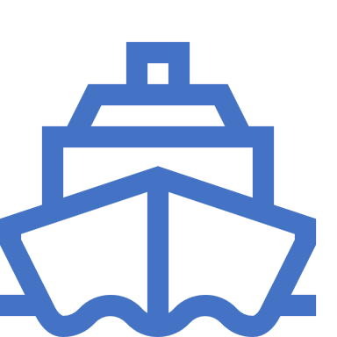
App and Route these days
App Route
www.application.com
Blue App
Green App

Slide 6
When You Upgrade Your App
App Route
www.application.com
Blue App

Slide 7
Blue Green Deployment
Before
After
Live Traffic
Blue App
Blue App
Green App
Live Traffic
Green App

Slide 8
Blue Green Deployment
Before
During
After
Blue App
Blue App
Blue App
Myapproute.com
Myapproute.com
MyappTempRoute.com
Green App
Green App
Green App
Myapproute.com
Myapproute.com

Slide 9
If you can’t handle the heat, stay away from the kitchen
Implications on App & Data Model Design

Slide 10
Serializing Objects
If Using Serializing Objects, Don’t Make Destructive Changes.
e.g. don’t remove fields, do have a serialVersionUID

Slide 11
Database Changes
Do Make Changes Idempotent.
e.g. Copy Data to new field, don’t delete data.

Slide 12
Database Changes
No DB destructive changes allowed.
e.g. Don’t drop a column.

Slide 13
Code Changes
Do have backward Compatible changes.
e.g. Try Overloading and Overriding.

Slide 14
DEMO
Time to get hands dirty

Slide 15
Develop 2 Apps
Develop Blue app with Rest Controller saying “ I Am A Blue App”.
Develop Green App with Rest Controller saying “ I Am A Green App”.

